Slide 1
Revenue model

Slide 2
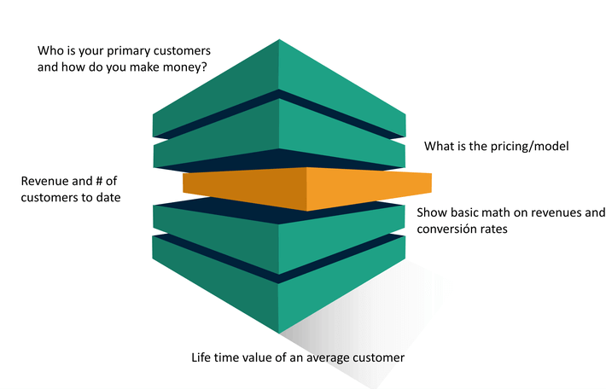
Revenue and no. of customers

Slide 3
Revenue Model
In business, revenue typically consists of the total amount of money received by the company for goods sold or services provided during a certain time period. Therefore, revenue models are a part of the business model. Many online companies generate revenues from multiple income streams such as advertising, subscription, affiliate marketing etc. Online models not only sell goods or services but also contacts and information.
Since there are possibilities of multiple variations, many companies do not use one single revenue model. They combine, for example : subscription fees with advertising and/or sales.

Slide 4
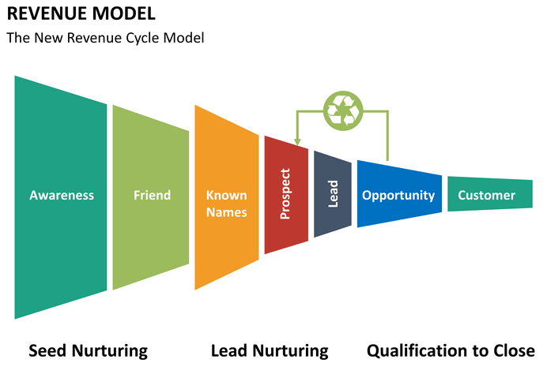

Slide 5
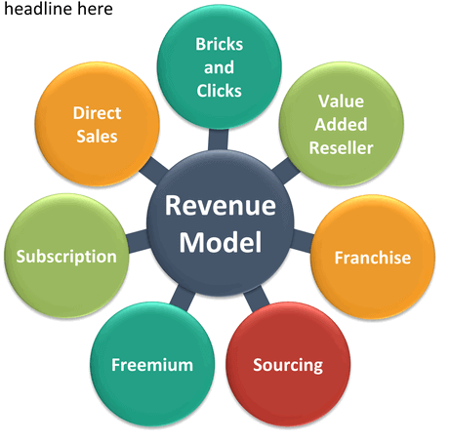
Types of Revenue Model

Slide 6
Advertising Revenue Model
Typically, fees are generated from advertisers in exchange for advertisements, which is ultimately the classic principal among the revenue models besides sales. Even if representatives of major media companies complain about earning less money with online advertising than with advertising in print or TV, the figures indicate steadily rising revenues.
The advertising revenue model is based on contacts making it one of the indirect sources of revenue. The conventional version is display-marketing - for example wallpaper, super banner, rectangle, skyscraper - which is paid according to traffic (invoice per CPC/cost-per-click or CPX/cost-per-action). The main online advertising variations are besides display-marketing, affiliate-marketing (advertising on many websites, CPX) and search-engine-marketing (CPC). Special models are e-mail-marketing and social-media-marketing. For advertisers with a lower budget for example the New York Times created a self-booking-tool for display-ads on a CPM(Cost-per-mille)-basis. And there are still rising new opportunities.
Examples
Google (e.g. AdWords and AdSense)
Facebook
New York Times(Marketing)

Slide 7
Subscription Revenue Model
Users are charged a periodic (daily, monthly or annual) fee to subscribe to a service. Many sites combine free content with premium membership, i.e. subscriber- or member-only content. Subscription fees do not depend on transactions. Subscribers use the content as long and often as they want.
Examples
Publishers and content services, e.g. newspapers, magazines, tv channels - they provide text, audio or video content to users who subscribe for a fee to get access to the service or to download the new issue: New York Times, Spiegel Online, Zattoo, Netflix
Networks offer premium memberships to find business partners or former classmates, subscribers can use all services, i.e. they get any information about their account via short notifications or newsletter, receive and send e-mails, get job offers: Xing, LinkedIn, Stayfriends.

Slide 8
Transaction Fee Revenue Model
A company receives commissions based on volume for enabling or executing transactions. The revenue is generated through transaction fees by the customer paying a fee for a transaction to the operator of a platform. The company is a market place operator providing the customer with a platform to place his transactions. During this process the customer may be presented as a buyers ,as well as a seller. To actively participate in this e-market, customers must register, so both parties of a transaction taking place are identified. From a business perspective, the offer is determined by others as customers offer their goods online and are acting as sellers. The amount of the transaction fee can be both – fixed and percentage calculated.
Examples
eBay
Amazon

Slide 9
Sales Revenue Model
Wholesalers and retailers of goods and services sell their products online. The main benefits for the customer are the convenience, time savings, fast information etc. The prices are often more competitive. In terms of online sales there are different models such as market places as common entry points for various products from multiple vendors.
Examples
the shops of single companies, sometimes based on web-catalogs (combines mail, online and telephone-ordering): Otto
e-retailers operating solely over the web: Amazon
marketplaces: Buy.com, Etsy

Slide 10
Affiliate Revenue Model
The affiliate program is an online distribution solution which is based on the principle of commission. Merchants advertise and sell their products and services through links to partner-websites. It is a pay-for-performance model: Commissions are only paid for actual revenue or measurable success. An affiliate-link includes a code, which identifies the affiliate. That’s how clicks, leads or sales are tracked. The affiliate therefore acts as the interface between merchants and customers. This model leads to a win-win situation: the merchants sell their products or services and the affiliates get their commissions. Variations include banner exchange, pay-per-click and revenue sharing programs. The affiliate model is well-suited for the web and therefore very popular.
Examples
Amazon
affilinet

Slide 11
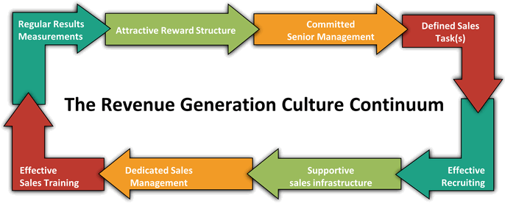

Slide 12
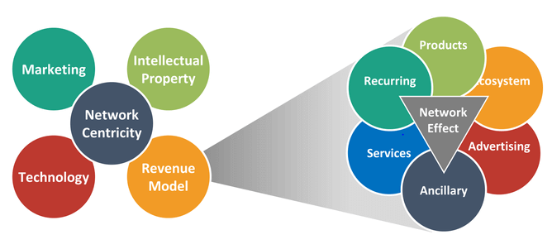
Revenue Streams

Slide 13
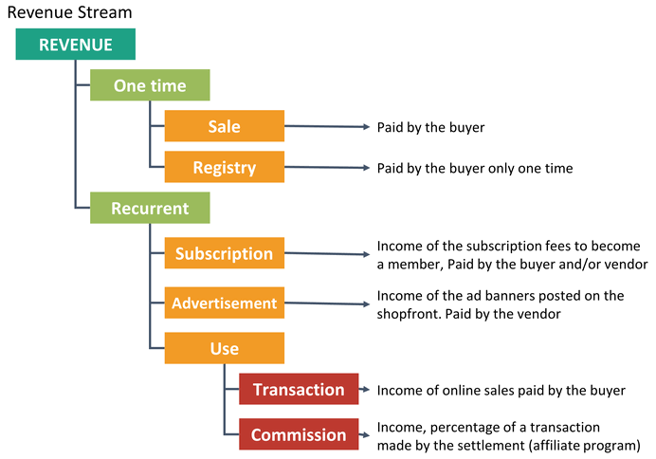

Slide 14
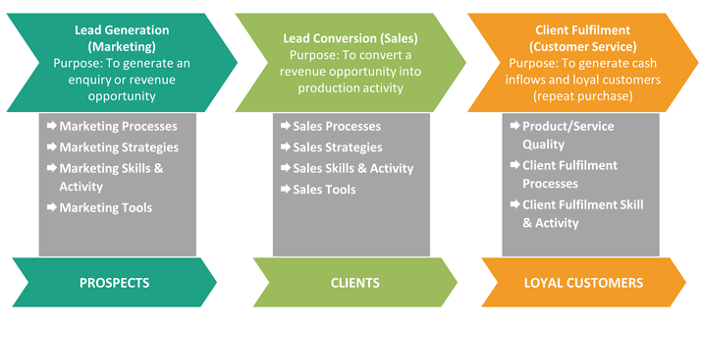
Revenue Generation Model

Slide 15
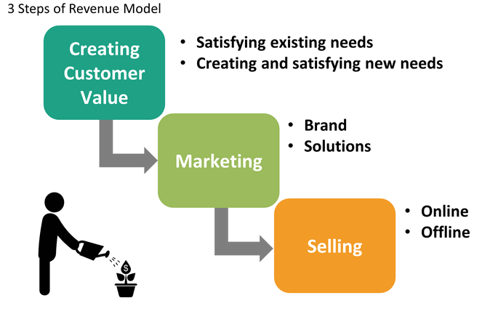

Slide 16
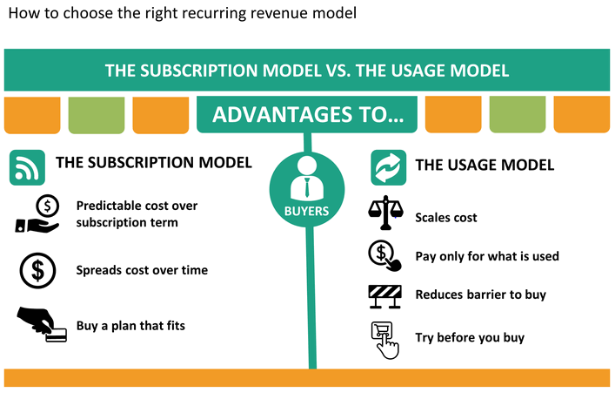

Slide 17
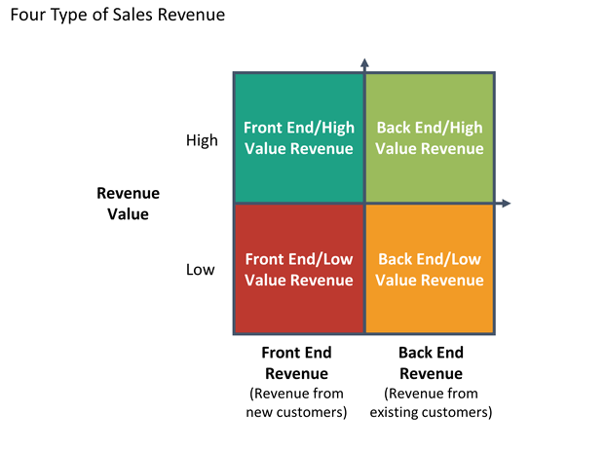

Slide 18
